Slide 1


The Task Force SAFE / UFC Program
Mission Brief
November 2025

Slide 2



Contents
Mission Brief
Introduction
  Program Overviews
    SAFE
    UFC
Program Operations
  Management
  Electricians
  UFC Team
  Property-Materials-Logistics Team

Slide 3

Contents
Mission Brief
QA/QC Process
  Definitions
  Workflow
  Submittal and Review
  Flow of Re-Inspections
Program Summary

Slide 4
Program Overview
The purpose of the Task Force SAFE / UFC program is to provide electrical and facility-related technical services including, but not limited to inspections, assessments, repairs, testing, reports, and training for facilities, and operations-related projects within the U.S. Army Central Command.
The program has two components:
  Task Force SAFE (TFS)
  Task Force UFC (UFC)

Slide 5
Program Overview
Task Force S.A.F.E. (TFS)
Safety Assessments for Fire and Electrical
Mission
  Task Force SAFE is tasked to INSPECT and REPAIR all DOD and Allied Force occupied facilities for Imminent Life, Health and Safety (LHS) issues on electrical systems 1000V and below throughout the ARCENT / CENTCOM AOR.
  TF SAFE ensures personnel and facilities are electrically safe by doing the following:
  Conducting inspections and repairs (LHS) of Non-Density (i.e., no O&M) buildings.
  Conducting inspections (and repairs when authorized) and QA for Density (i.e., O&M available) buildings. Density repair on case-by-case basis in coordination with O&M KO.
  Conducting QA for contracted work to ensure electrical compliance.
  Offering assistance with gaining electrical materials available in our Electrical Bill of Materials (EBOM).
  Offering assistance with electrical language in contracts.

Slide 6
Program Overview
Task Force S.A.F.E. (TFS)
Safety Assessments for Fire and Electrical
History
  Task Force SAFE is a congressionally mandated program and our mission, as the electrical safety surveillance arm for he military, is to ensure that all DOD occupied facilities are inspected for electrical Life, Health, Safety (LHS), (Urgent) hazards as well as all non-code compliant (Priority) electrical conditions.
  Task Force SAFE, CENTCOM provides support to ARCENT and CENTCOM’s electrical safety program by providing qualified licensed electricians performing inspections and repairs across the CENTCOM theatre along with the management of the Task Force SAFE electrical materials yard located at Camp Arifjan, Kuwait.

Slide 7
Program Overview
Task Force S.A.F.E. (TFS)
Safety Assessments for Fire and Electrical
History
  In 2008, there were 14 fatalities in Iraq of U.S. personnel due to electrocution, and many more were injured to varying degrees from electric shock. A Congressional Investigation was undertaken in Iraq to investigate these hazards and it was determined that unqualified host nation contractors, third country contractors, and defense contractors on the BOS-I/LOGCAP contract were facilitators of the problem. These groups comprised the enforcement of the Uniform Facilities Code (UFC), which establishes “the minimum requirements” for OCONUS construction; the National Fire Protection Act (NFPA) 70; the National Electric Safety Code (NESC); the National Electric Code (NEC); the American Standards Institute (ANSI) C2 and the British Standard Code (BS-7671). Lack of awareness and understanding of the risks associated with electrical hazards, missing requirements in construction contracts, and lack of technical experts to effectively enforce the standards created a serious problem. It was acknowledged that these incidents could have been prevented if proper safeguards and measures had been in place to ensure electrical code compliance with new construction and existing structure renovations.
“After Deaths, U.S. Inspects Electric Work Done in Iraq”, James Risen, 2008,
http://www.nytimes.com/2008/07/01/washington/01electrocute.html?_r=0

Slide 8
Program Overview
Task Force S.A.F.E. (TFS)
Safety Assessments for Fire and Electrical
History
  TF Power was established by the Combined Joint Task Force-101 (CJTF-101) in October 2008, to “prevent the loss of life and government property through immediate and long-term measures that will significantly reduce the numbers of electrical and fire incidents throughout the combined (Joint Operations) area.” At that time, TF Power was a part of Task Force Safety Actions for Fire and Electricity (TF SAFE), due to the 14 fatalities in Iraq related to electrical hazards in 2008. TF POWER re-named TF SAFE for ARCENT / CENTCOM AOR in 2016 to prevent confusion in theater with military Prime Power assets.
    The non-combat deaths resulted in the Inspector General's Report No. SPO-2009-005 Assessment of Electrical Safety in Afghanistan, dated 24 July 2009.
    Resulting in the Congressional Mandate, National Defense Authorization Act (NDAA)
    FY 2010 Section 807 Policy and Requirements to Ensure the Safety of Facilities, Infrastructure, and Equipment for Military Operation, dated 28 October 2009.
    The USFOR-A Fragmentary Order (FRAGO) 10-213, dated July 2010, that establishes a theater-wide electrical and fire safety programmed outlines parameters for the TF POWER program.
    Leading to the Policy Letter USARCENT Theater Electrical Standards, dated 22 January 2016, which was superseded by Policy Letter #30.1, dated 8 May 2014.

Slide 9
Program Overview
Task Force S.A.F.E. (TFS)
Safety Assessments for Fire and Electrical
TASK FORCE SAFE is a Safety Organization
  They are the Authority Having Jurisdiction (AHJ) for all electrical matters 1000V and below in the CENTCOM AOR.
  They are the Electrical Subject Matter Experts (SMEs) in theater.
  The teams are comprised of licensed Master and Journeyman Electricians from both the U.S. and U.K.
  They will provide all materials to affect repairs on Imminent Life Health Safety (LHS) issues on 1000V and below electrical systems for non-density facilities and for density facilities when authorized by the COR.
  They will complete a comprehensive hands-on evaluation of the electrical system from the source to the final device / end user.

Slide 10
Program Overview
Task Force U.F.C. (UFC)
Unified Facilities Criteria
Mission
  TASK FORCE UFC is tasked to assess a facility to determine if the building achieves the minimum Life Safety and Habitability requirements to allow for occupancy in support of military operations and to provide options for mitigating the risks inherent with common building deficiencies to ensure protection of life safety and health of personnel occupying these facilities.
  For practical assessment of facilities to ensure the minimum standards for Life, Safety and Health of personnel consistent with the requirements of military operations in the following disciplines:
  Fire Protection (includes Life Safety)
  Structural Integrity
  Electrical Systems
  Plumbing and Mechanical Systems
  Telecommunications Networks
  Other Hazards

Slide 11
Program Overview
Task Force U.F.C. (UFC)
Unified Facilities Criteria
Mission
  There are two levels of evaluation for facility occupancy:
  Preliminary Evaluation
  Detailed Evaluation
  The Preliminary and Detailed Evaluations assess different items, and both evaluations are necessary to ensure building safety and habitability.

Slide 12
Program Overview
Task Force U.F.C. (UFC)
Unified Facilities Criteria
Mission
  The items assessed are limited to requirements that affect Life, Safety and Health of occupants. Successful completion of an evaluation and mitigation of any deficiencies provides a level of safety to building occupants as described for the given evaluation level, for the duration defined for the given evaluation level. If the use of the building changes or the building systems are impacted by an adverse event (high winds, earthquakes or other battle damage), previous evaluations are no longer valid. In this situation, re-evaluate the building to re-establish the desired level of safety.
 | Preliminary | Detailed
Purpose | Minimal level of safety for expedient, limited-use occupancy | Moderate level of safety for broader-use occupancy
Focus | Extreme hazards posing imminent danger, less electrical and mechanical systems | Near-term risks to safety and health, including electrical and mechanical systems
Valid Period | 90 days | 5 years

Slide 13
Program Overview
Task Force SAFE / UFC
Stake Holders
  Military Clients
    In order to provide the best service possible, the following actions can assist the Task Force SAFE team inspections efficiencies:
    Provide a single point of contact for TF SAFE / UFC to coordinate accordingly.
    Provide a list of facilities for inspection.
    Prioritize inspection and repair of facilities.
    Provide billeting for teams.
    Provide office space for our electricians.

Slide 14
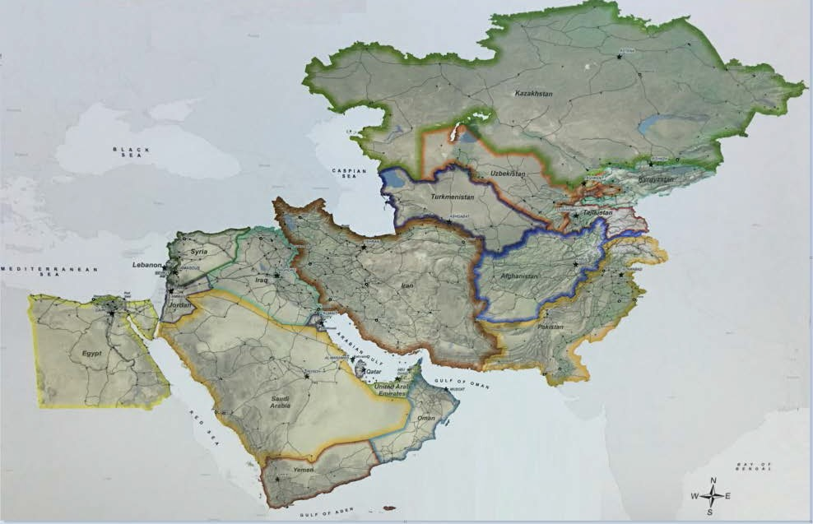
Program Operations – Management
Task Force SAFE / UFC
Task Force SAFE
Current Team Locations
In
CENTCOM
Contractual Requirements
Kuwait
Project Manager (PM) | 1
Property Manager | 1
Site Safety and Health Officer (SSHO) | 1
Materials Controls Supervisor | 1
Materials Controls Specialist | 1
  Note:
  Program Director / Manager (PD / PGM) is a remote position in US.
  Quality Assurance / Control Manager position is remote in the UK along with the QA/QC team.
JORDAN
Area of Operations Lead (AOL) | 1
Field Office Administrator (FOA) | 1

Slide 15
Program Operations - Management
Task Force SAFE / UFC
  The responsibility begins with the Program Director /Manager and the Project Management Office (PMO) staff.
  The Project Manager (PM) will be the most visible to the customer /client and is the face of the program. The PM roles and responsibilities are clearly defined in details.
  There is no ambiguity as to what staff member does what and to whom they report to.
  PMO staff members are located at offices in Kuwait and Jordan, and the Program Director/Manager is in the USA.

Slide 16
Program Operations - Management
Task Force SAFE / UFC
Project Manager
Site Safety and Health Officer
Quality Control Manager
Field Office Administrator
Property Manger
Area of Operations Lead
UFC Team Lead
Fire Prevention Specialist
3 QC Specialists
3 Electrical Teams
ARCENT
9 Electrical Teams
OIR
UFC Civil Eng
UFC Mech / Plumb Specialist
UFC Environmental Specialist
UFC Electrical SME
Materials Control Supervisor
Materials Control Specialist
Program Director / Manager
PMO Staff

Slide 17
Program Operations - Management
Task Force SAFE / UFC
Program Director / Manager (PD / PGM)
  Provides single POC coordination for stateside-required logistics/administrative support; ensures sufficient resources are available (staff/equipment) to support ongoing tasks.
Project Manager (PM)
  Provides overall management and addresses contracting issues
  Coordinates inspection activities with CEHNC, confirms priorities, schedules and directs/coordinates resources to meet demands across the CENTCOM AOR

Slide 18
Program Operations - Management
Task Force SAFE / UFC
Area of Operations Electrical Lead (AOL)
  Directs/coordinates electrical teams to efficiently perform tasks through-out CENTCOM and at outlying bases.
Quality Assurance / Control Manager
  Provides overall quality management, including training, auditing, corrective actions, and continuous improvement.
  Updates repor1ing templates, distributes reports to CEHNC through REDi.
  Responsible for Quality Specialists working remotely in the UK.

Slide 19
Program Operations - Management
Task Force SAFE / UFC
Property Manager
  Maintains up-to-date Government property records/documentation and tracks/accounts for all GP/CAP inventory.
Materials Controls Supervisor
  Perform management and operation of the EBOM containers.
  Warehousing, logistics, shipping, and materials management.
Materials Controls Specialist
  Assist the Materials Control Supervisor with warehousing, EBOM management, and operating heavy equipment.

Slide 20
Program Operations - Management
Task Force SAFE / UFC
Site Safety and Health Officer (SSHO)
  Ensures all work is performed safely IA W TF SAFE AAP/ SSHP, AHAs, and SOPs; enforces safe work practices
  Ensures work is performed IA W USA CE EM 385-1-1.
Field Office Administrator (FOA)
  Provide overall daily suppor1 and general office support to the PMO.

Slide 21
Program Operations – Electricians
Task Force SAFE / UFC
Task Force SAFE
Current Team Locations
In
CENTCOM
Contractual Requirements
Syria
Al - Tanf Garrison (ATG) | 2 Teams
Rumalyn Landing Zone (RLZ) | 1 Team
Northern Landing Zone (NLZ) | 3 Teams
Shaddadi (PBS) | 1 Team
ARCENT (3 Teams)
OIR (9 Teams)
  24 Electricians
  12 Teams
  Ratio of 70% (UK) to 30% (US)
JORDAN
JTC / H5 / Tower 22 | 2 Teams
IRAQ
Erbil | 2 Team
Kuwait
Camp Buehring | 1 Team

Slide 22
Program Operations – Electricians
Task Force SAFE / UFC
What Have They Done?
From 31 Jul 2020 to 30 Sep 2025, TFS did the following:
  Facilities Inspected / Re-Inspected – 15855
  Deficiencies Found – 336365
  Deficiencies Repaired / Mitigated – 123435
  Percentage of Items Repaired / Mitigated – 54%
    TFS (25%) – O&M (20%) – Military (9%)

Slide 23
Program Operations – UFC Inspection Team
Task Force SAFE / UFC
Task Force UFC
Current Team Location
In
CENTCOM
Contractual Requirements
Jordan
Electrical | 1 Engr
Structural | 1 Engr
Mechanical / Plumbing | 1 Engr / Specialist
Fire Protection | 1 Engr / Specialist
Environmental | 1 Engr / Specialist
Note:
The Fire Protection Engineer is a Reachback position in the US.
The Electrical Engineer’s position has been waived for a Master Electrician

Slide 24
Program Operations – UFC Inspection Team
Task Force SAFE / UFC
What Have They Done?
From 4 Jan 2025 to 30 Sep 2025, UFC team did the following:
  Facilities Inspected – 167
    Kuwait, Jordan and Saudi Arbia
  Facilities Reported as Habitable – 151
  Facilities Reported as Un-Habitable – 16

Slide 25
Program Operations – Materials-Logistics Team
Task Force SAFE / UFC
Task Force UFC
Current Team Location
In
CENTCOM
Contractual Requirements
Kuwait
Property Manager | 1
Materials Control Supervisor | 1
Materials Control Specialist | 1

Slide 26
Program Operations – Property-Materials-Logistics Team
Task Force SAFE / UFC
What Have They Done?
From 4 Jan 2025 to 30 Sep 2025, the team did the following:
  Maintained 100% accountability of all TF SAFE/UFC government and contractor property and materials valued at nearly $2.2 Million dollars and totaled over 65000 items in seven countries throughout the AOR.
  Completed procurement activities to supply electricians throughout the AOR with components needed to repair electrical deficiencies by shipping 16250 items.

Slide 27
Program Operations – Site Safety and Health Officer
Task Force SAFE / UFC
Task Force UFC
Current Team Location
In
CENTCOM
Contractual Requirements
Kuwait
Site Safety and Health Officer (SSHO) (Master Electrician Required) | 1
Note:
The SSHO position has been waived for a Health and Safety Professional

Slide 28
Program Operations – Property-Materials-Logistics Team
Task Force SAFE / UFC
What Have They Done?
From 4 Jan 2025 to 30 Sep 2025, the team did the following:
  Maintained 100% accountability of all TF SAFE/UFC government and contractor property and materials valued at nearly $2.2 Million dollars and totaled over 65000 items in seven countries throughout the AOR.
  Completed procurement activities to supply electricians throughout the AOR with components needed to repair electrical deficiencies by shipping 16250 items.

Slide 29
Definitions
Program Operations – QA/QC Process
Task Force SAFE / UFC
LHS Electrical Deficiency:
  A deficiency that is, in its current state, likely to bring harm or damage.
Imminent LHS Electrical Deficiency:
  A deficiency that, in its current state, is certain to bring harm or damage.
Mitigated:
  An action taken to reduce an LHS deficiency.

Slide 30
Definitions
Program Operations – QA/QC Process
Task Force SAFE / UFC
RAC – Risk Assessment Code:
  To provide guidance for safety personnel by representing the severity of identified deficiencies; meant for information purposes only.
RAC 1:
  Immediate danger to public or property with critical to catastrophic consequences.
RAC 2:
  Possible danger to public or property with significant consequences.
RAC 3:
  Unlikely to cause danger to public or property with minor consequences.

Slide 31
Workflow
Program Operations – QA/QC Process
Task Force SAFE / UFC
Inspections will be carried out from source to end users.
When a LHS deficiency is identified, it will always be documented, at the time it was found.
If an unsafe deficiency is found it will never be left in its current condition. An unsafe deficiency will either be repaired or mitigated.
Mitigating actions could include, but are not limited to, isolating the supply, posting warning signs and/or barriers or informing the POC on site.
On recording any LHS deficiency, it will be recorded at the status as to which it was initially inspected.
Reporting systems have been implemented by TFS, to provide a true reflection of the condition of all inspected electrical systems and facilities throughout CENTCOM.

Slide 32
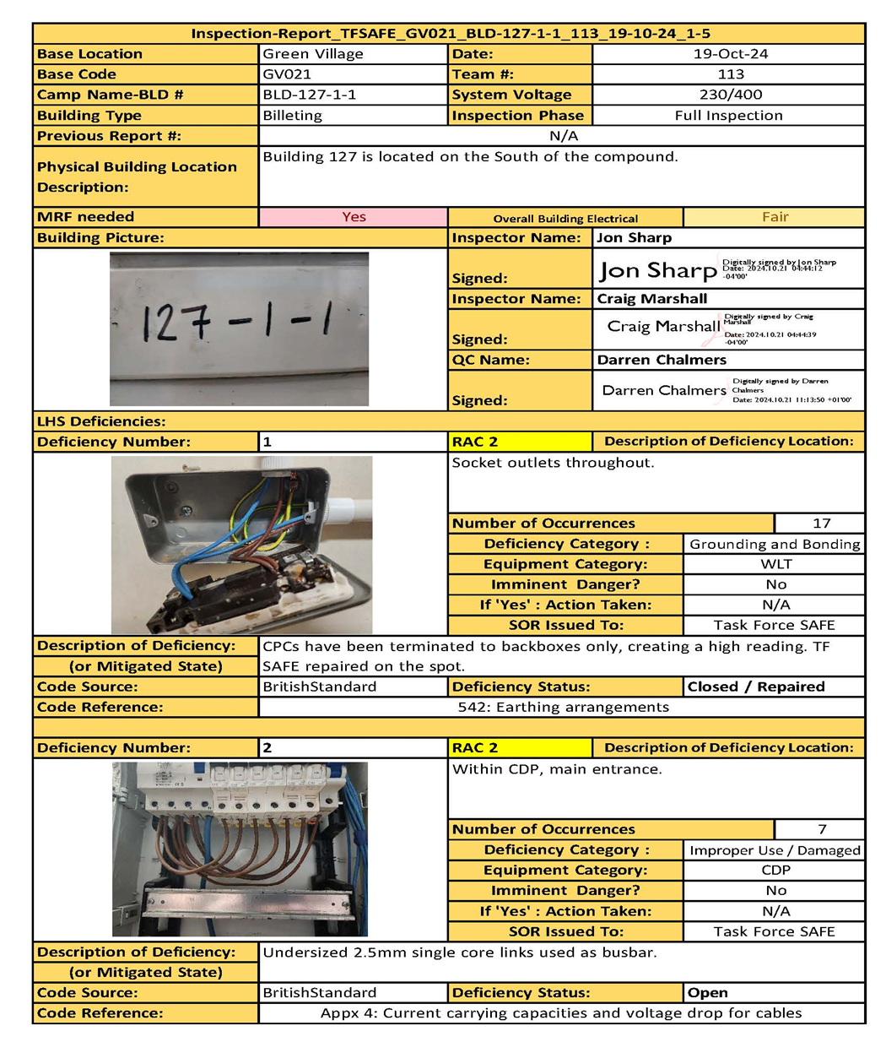
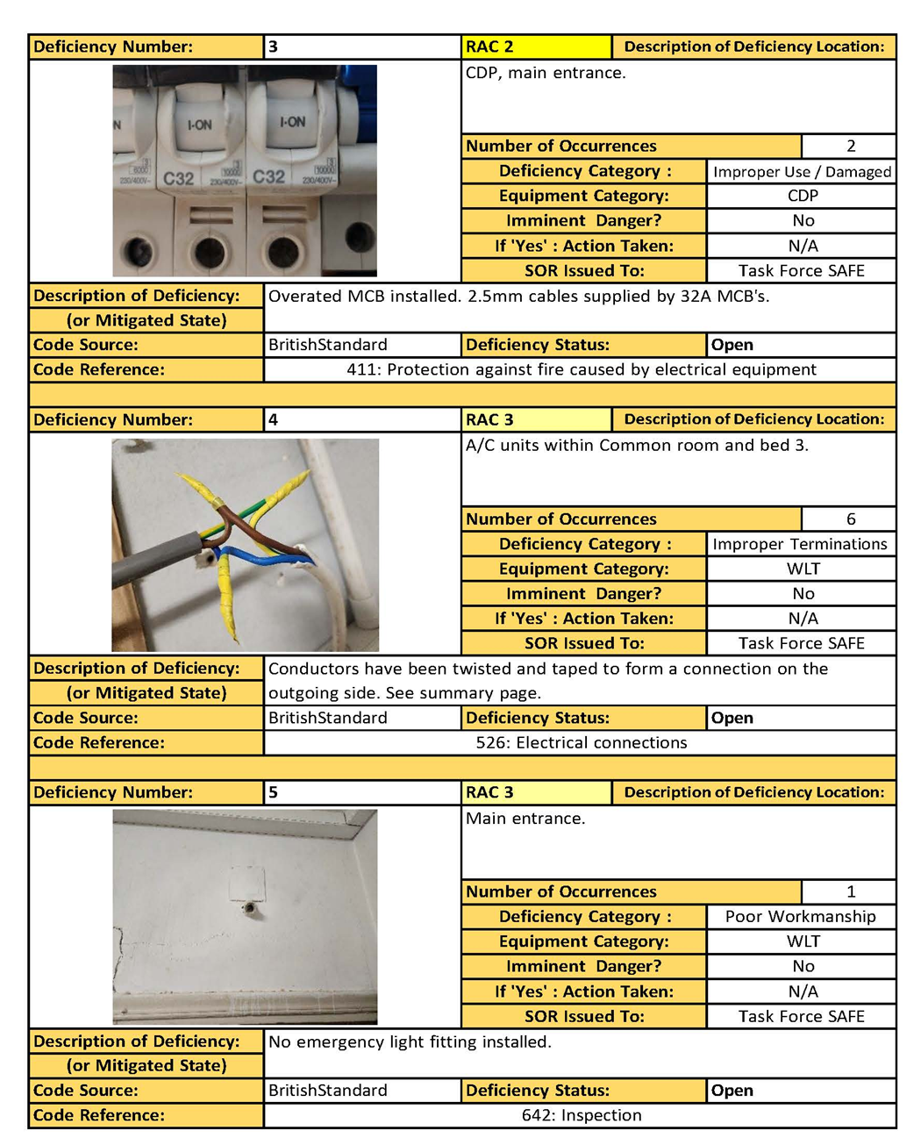

Slide 33
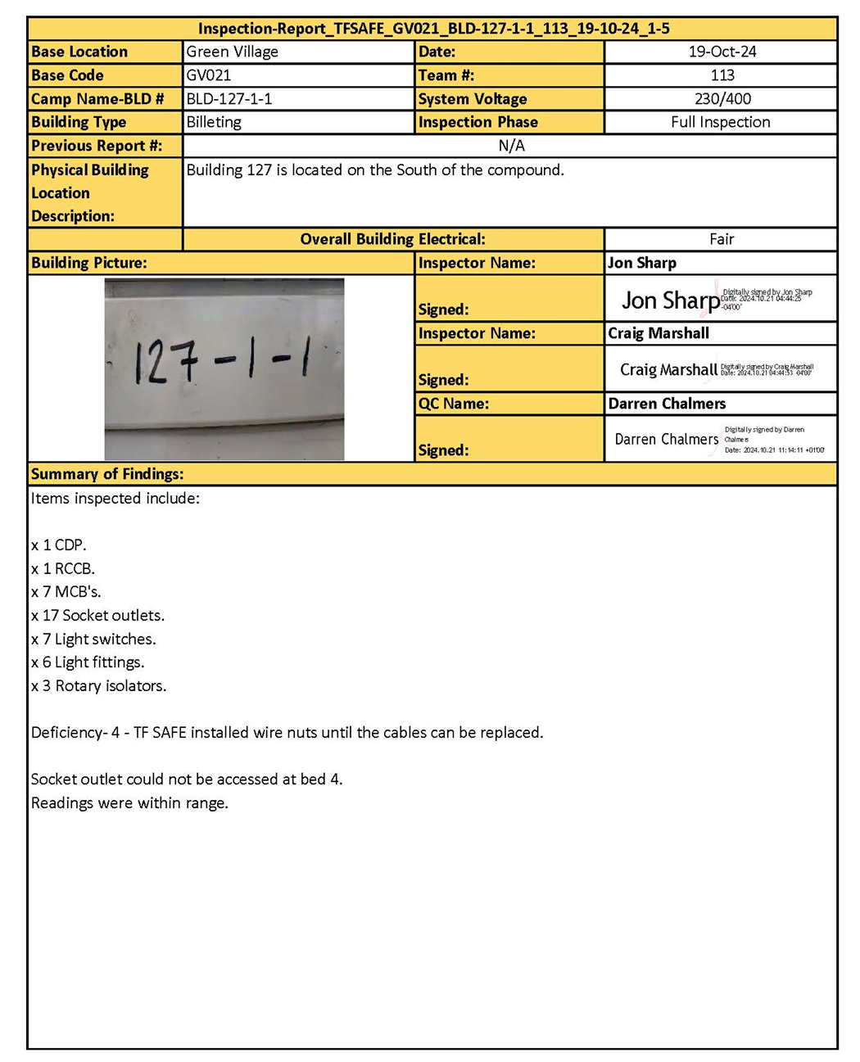

Slide 34

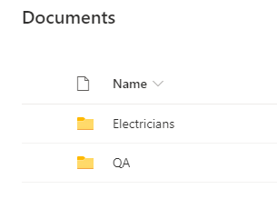
Program Operations – QA/QC Process
Task Force SAFE / UFC
Reviewing of Reports
Send link to inspectors
Receive email from inspector that report is submitted
Make a PDF of report and sign
Add report to file 2.Signature Required
Inspector signs report and moves to file
3. Signed Report
Check file for new reports
1. Submitted Report
QA report and remove file from
1.Submitted Report
Update Tracker
Move the Excel file to
Completed Reports
Make a copy and archive file in Main QA file

Slide 35

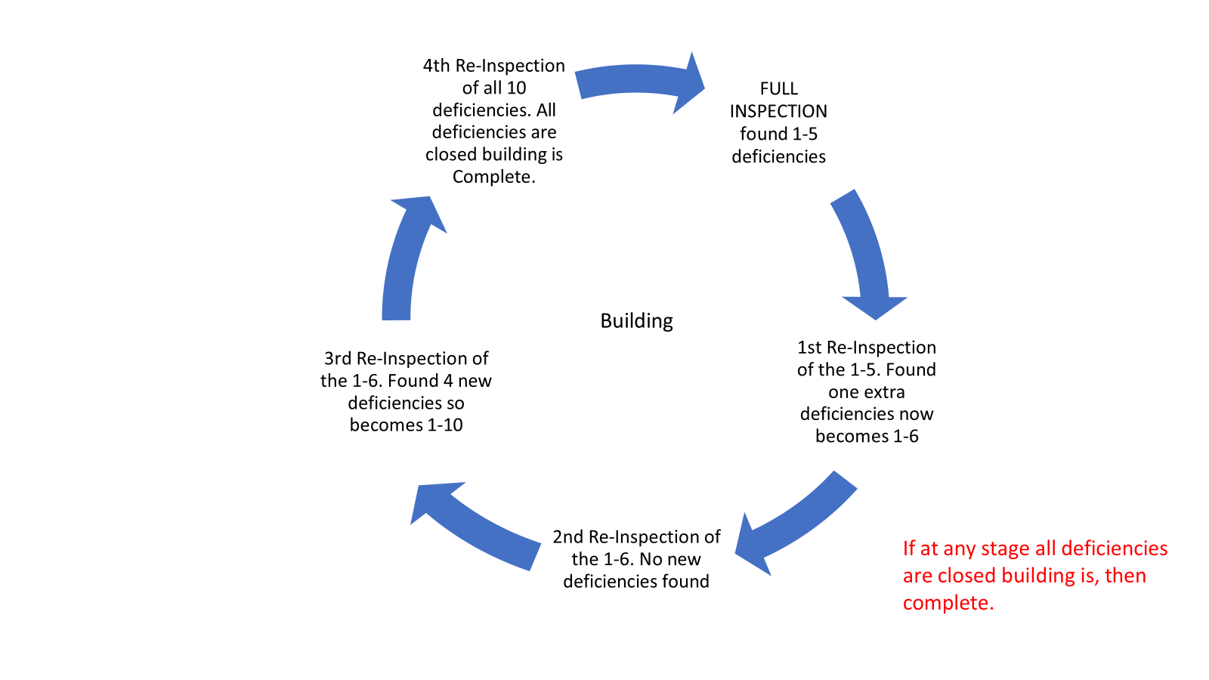
Program Operations – QA/QC Process
Task Force SAFE / UFC
Flow of Inspections
Make a PDF of report and sign
Update Tracker

Slide 36
Program Summary
This program plays a vital role in safeguarding personnel and facilities, reducing risks, and ensuring operational readiness in challenging environments.
The TF SAFE / UFC teams provides knowledge from subject matter experts therefore delivering safe operating conditions within the CENTCOM
Because of the nearly 340000 deficiencies identified and over 40000 deficiencies repaired, the field teams have prevented an immeasurable number of electrocutions, shocks, and fires from facility occupants throughout the AOR.

